Slide 1
Digital Portfolio
STUDENT NAME: VIJAYALAKSHMI D
REGISTER NO AND NMID: 24724U09044 AND E64F5955ACA43288F2545050364C5CA0
DEPARTMENT: BCA
COLLEGE: CHEZHIAN ARTS AND SCIENCE COLLEGE FOR WOMEN/THIRUVALLUVAR UNIVERSITY

Slide 2
PROJECT TITLE
CREATIVE DESIGNER PORTFOLIO

Slide 3


AGENDA
Problem Statement
Project Overview
End Users
Tools and Technologies
Portfolio design and Layout
Features and Functionality
Results and Screenshots
Conclusion
Github Link
3/21/2024 Annual Review

Slide 4

PROBLEM STATEMENT
Many students and designers lack a professional platform to showcase their skills.
Traditional resumes are static and don’t effectively highlight creativity & technical ability.
Recruiters need a quick, interactive, and engaging way to evaluate candidates.
Solution → A digital portfolio website that combines design + functionality.

Slide 5

PROJECT OVERVIEW
This project is a web-based portfolio designed using HTML, CSS, and JavaScript.
It highlights:
Personal branding (About Me, Skills, Resume).Project showcase (Design works, UI/UX, Web projects).
Interactive features (animations, contact form).
Goal: To create a professional, creative, and responsive portfolio.

Slide 6

WHO ARE THE END USERS?
Students & Freshers – to showcase projects and skills.
Creative Designers – for branding, design works, and portfolio.
Job Recruiters – to quickly evaluate candidates.
Freelancers – to attract clients and display services.

Slide 7

TOOLS AND TECHNIQUES
Frontend Languages:
HTML → Structure
CSS → Styling & Layout
JavaScript → Interactivity Design
Tools (optional): Photoshop, Figma/Canva for UI mockups.

Slide 8
POTFOLIO DESIGN AND LAYOUT
Homepage: Hero section with name, tagline, and CTA button.
About Section: Personal introduction & design philosophy.
Projects Section: Grid layout with project cards
Contact Section: Simple form (name, email, message)
8

Slide 9
FEATURES AND FUNCTIONALITY
Responsive design for mobile, tablet, desktop.
Smooth scroll animations.
Interactive hover effects on project cards.
Contact form with JavaScript alert/validation.
Easy navigation with sticky nav bar.
Customizable theme (dark/light mode optional).

Slide 10

RESULTS
Screenshots of your portfolio webpage:
Homepage
About Section
Projects Section
Contact Form
Highlight key UI/UX aspects.
3/21/2024 Annual Review
10

Slide 11
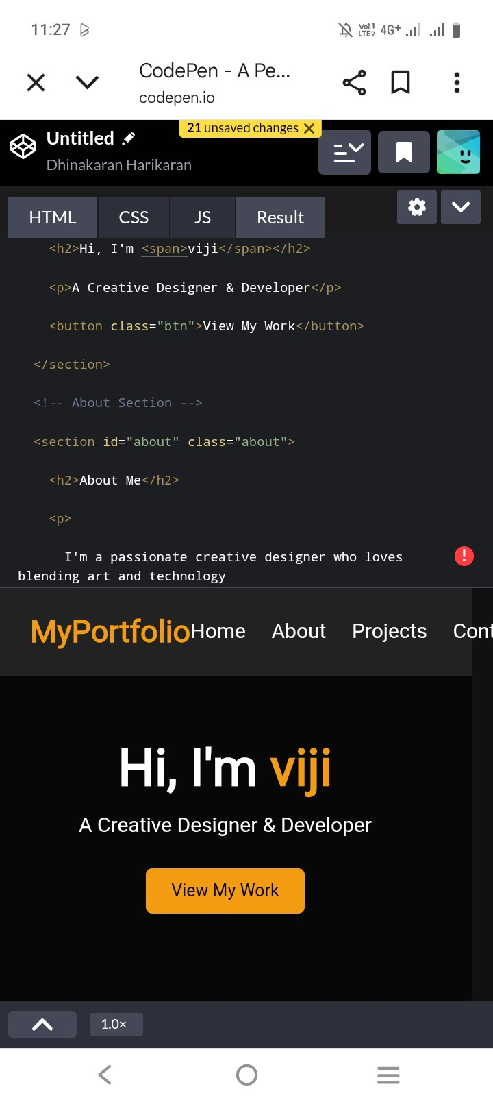
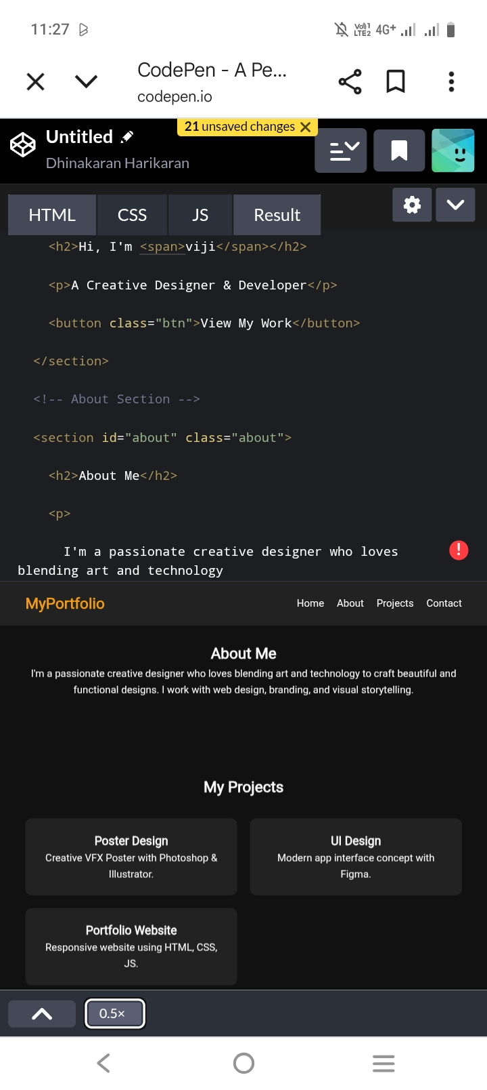
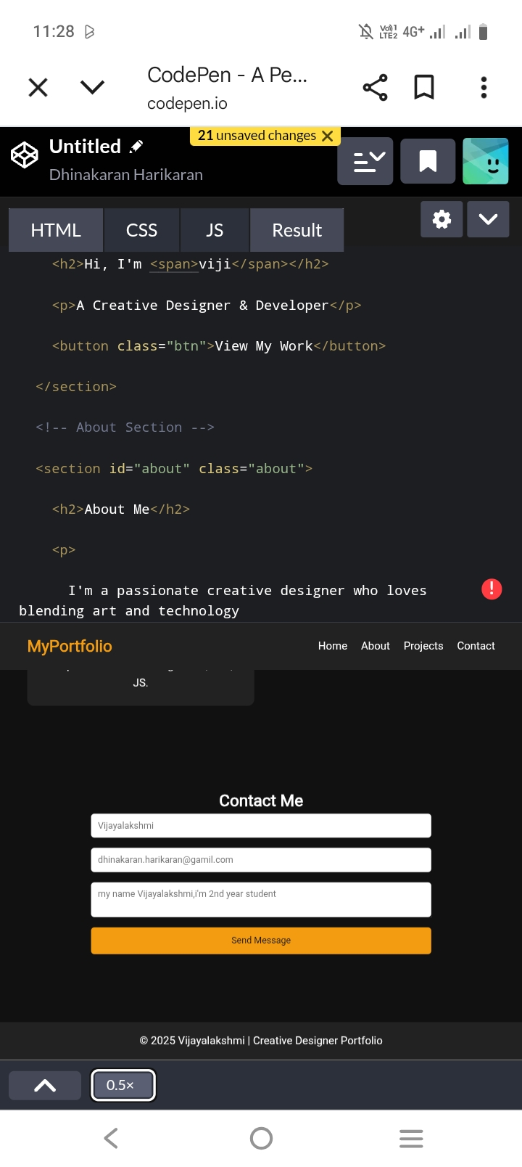
SCREENSHOTS

Slide 12
GUTHUB LINK
https://github.com/viji-lakshmi143/Creative-designer-portfolio-.git

Slide 13
CONCLUSION
The project successfully demonstrates:
Creativity in design
Technical skills in web development
Usability for career building
Learning Outcomes:
Improved skills in HTML, CSS, JS
Experience in UI/UX and responsive design
Knowledge of hosting via GitHub Pages
13

